Slide 1
An overview of faithfulness in natural language generation
Qi Jia
Notes:
Hi, everyone, Today I’ll give an overview of faithfulness in natural language generation tasks

Slide 2
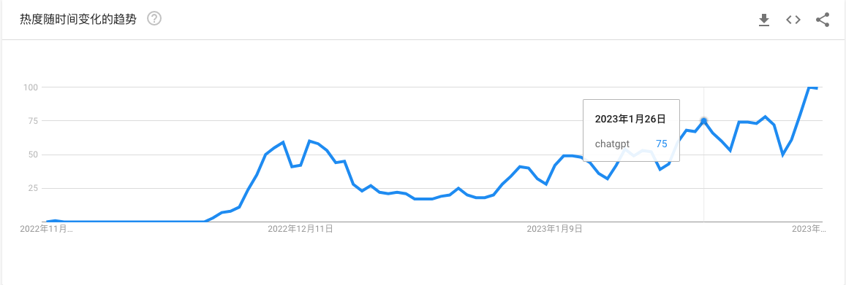
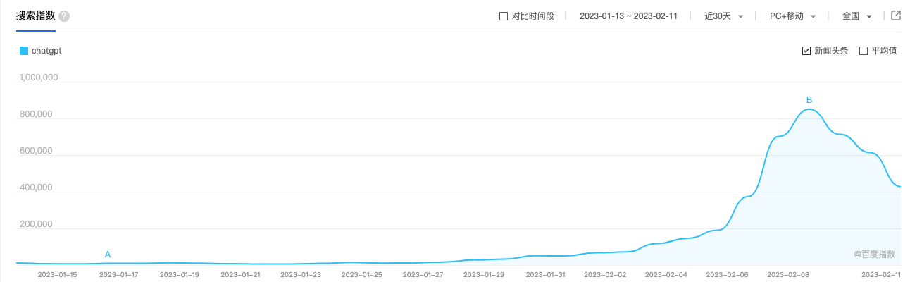
ChatGPT
Notes:
As we all know, ChatGPT is a quite hot topic these days, which can be reflected by Searching Trends from Google & Baidu. And more competitive models and applications are showing up. However, these models may be disappointing .

Slide 3
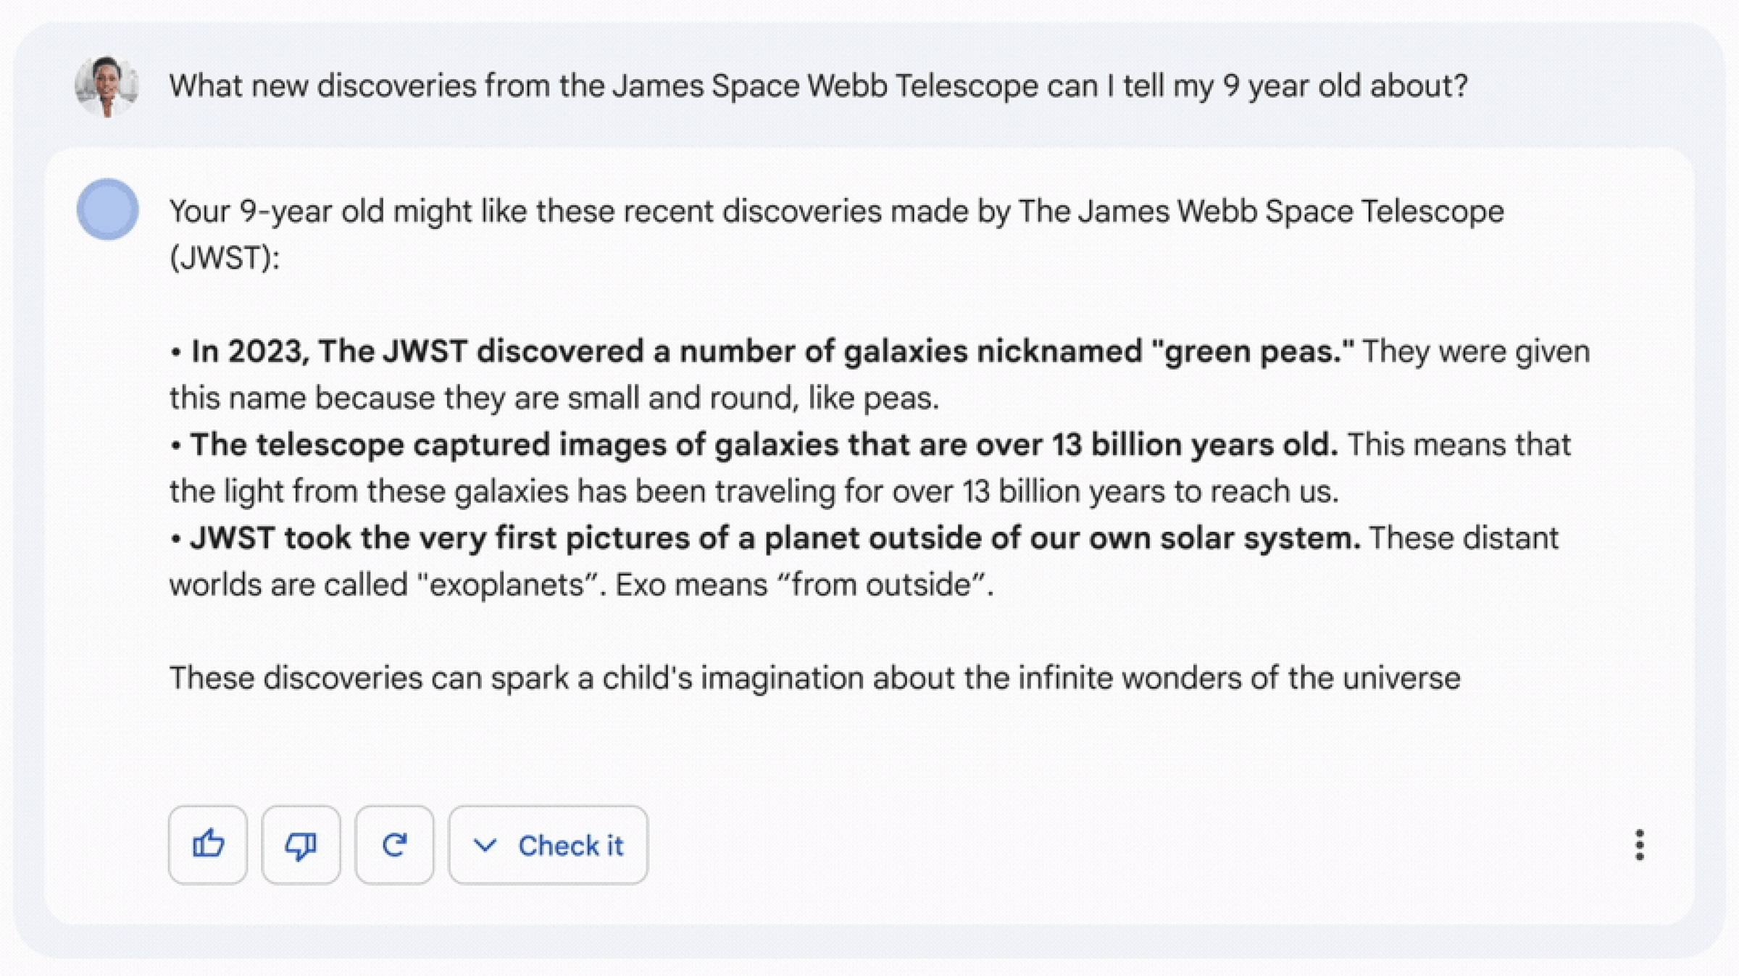
Bard
Bard’s very first answer contained a factual flub.
Bard’s first public mistake cost Google $100 billion
JWST did not take "the very first image of a planet outside our solar system".
the first image was instead done by Chauvin et al. (2004) with the VLT/NACO using adaptive optics.
Notes:
For example,the Bard’s very first answer contained a factual flub.

Slide 4


New Bing
Providing the information source.
Merging (Summarizing) information from different sources.
Generating wrong facts.
Notes:
models like ChatGPT etc. are often *very confidently* wrong
Exchange rate of USD against RMB

Slide 5
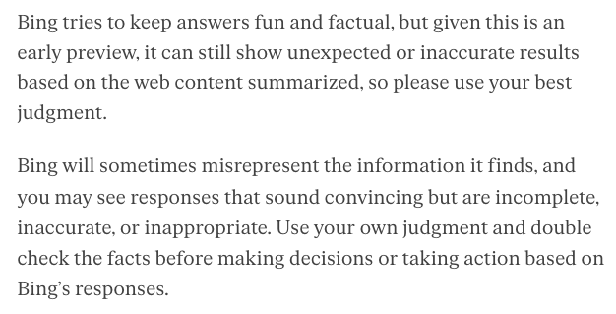
Microsoft’s new Bing FAQ
Notes:
Therefore, evaluating and increasing the faithfulness or reducing hallucination in generated text is of great importance and urgency.

Slide 6
Hallucination in NLG
Representative NLG tasks
Definition & Categorization
Contributors
Evaluation Metrics
Future Directions for Evaluation Metrics

Slide 7
Representative NLG tasks
Abstractive Summarization
Summary
Document
justin timberlake and jessica biel , welcome to parenthood . the celebrity couple announced the arrival of their son , silas randall timberlake , in statements to people . `` silas was the middle name of timberlake 's maternal grandfather bill bomar , who died in 2012 , while randall is the musician 's own middle name , as well as his father 's first , '' people reports . the couple announced the pregnancy in january …… it is the first baby for both .
Model
timberlake and biel welcome their first baby, silas randall timberlake .
Notes:
extract essential information from source documents and to generate short, concise, and readable summaries

Slide 8
Representative NLG tasks
Dialogue Generation
Dialog History: Speaker 1: What do you think about Murray? Speaker 2: I think Murray is a great player he just needs to stay healthy in order to compete more. Who do you like best? Knowledge:
In tennis, the term Big Four refers to the quartet of men’s singles players comprising Roger Federer, Rafael Nadal, Novak Djokovic, and Andy Murray.
Model
Response:
Speaker 1: I like Roger Nadal the most!
Notes:
automatically generates responses according to user utterances. The generated responses are required to be fluent, coherent, and consistent with the dialogue history.

Slide 9
Representative NLG tasks
Generative Question Answering
Question:
Where was Alan Turing born?
Model
Answer
Maida Vale, London
Candidate Documents
Alan Turing was a British computer scientist. Born in Maida Vale, London …
Notes:
generate an abstractive answer to a given question from provided passages
a GQA system involves searching an external knowledge source for information relevant to the question.
Then it generates the answer based on the retrieved information.
In most cases, no single source (document) contains the answer, and multiple retrieved documents will be considered for answer generation.

Slide 10
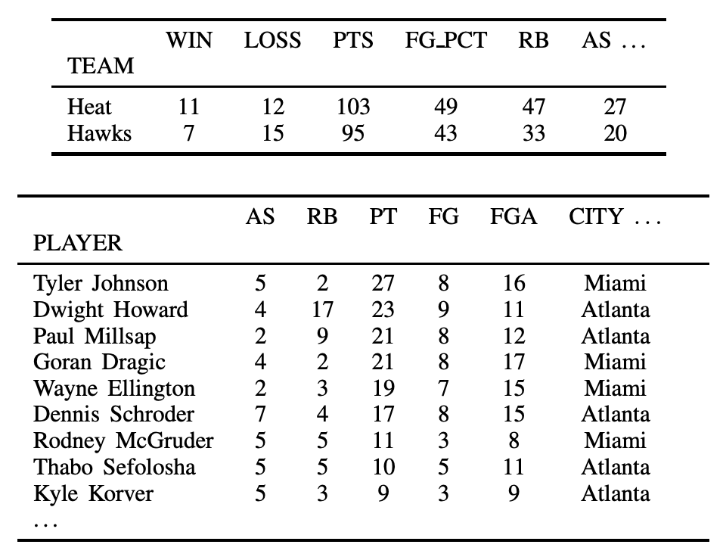
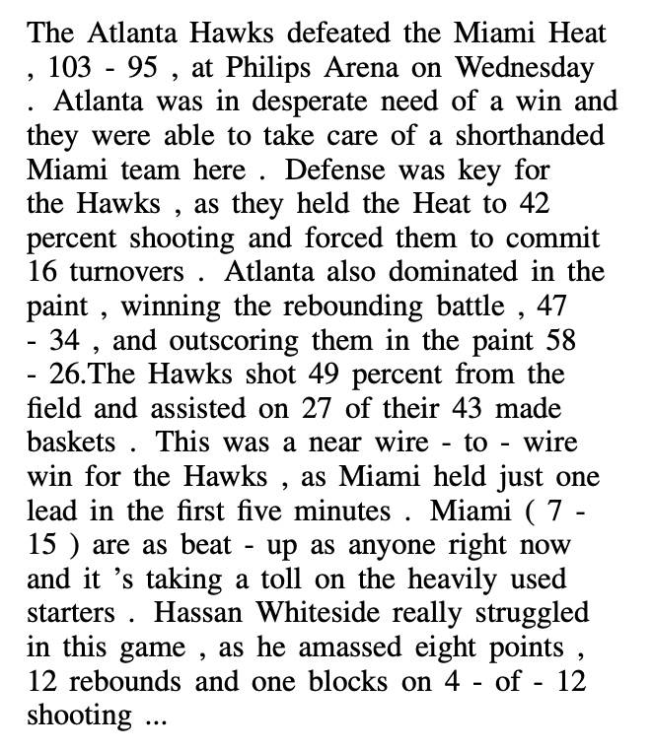
Representative NLG tasks
Data-to-text Generation
Structured Data:
Text Document:
Model
Notes:
generating natural language descriptions conditioned on structured data, such as tables [100, 149], and knowledge graphs
a subset of the game’s records
%%%
taking structured data, such as a table, as input, and producing text that adequately and fluently describes this data as output. Unlike machine translation, which aims for a complete transduction of the sentence to be translated, this form of NLG is typically taken to require addressing (at least) two separate challenges: what to say, the selection of an appropriate subset of the input data to discuss, and how to say it, the surface realization of a generation

Slide 11
Representative NLG tasks
Machine Translation
Source Language
Target Language
Model
杰瑞星期四去了书店。
Jerry went to the bookstore on Thursday.
Notes:
the task of generating translation of the source language into the target language via inference,
Input, output pairs
given parallel data samples for training

Slide 12
Definition of Hallucination
The generated content that is nonsensical or unfaithful to the provided source content
Other terms:
Faithfulness (antonym)
Factually (different / indistinguishable from faithfulness)
Consistency (in dialogue generation)
Adequacy (in machine translation)
Notes:
defining the “fact” to be the world knowledge.
And use the source input as the “fact” to determine the factual correctness,
In this following part, we will mainly use the term hallucination or faithfulness in this talk.

Slide 13
Categorization of Hallucination
Intrinsic Hallucination
The generated output contradicts the source content.
Extrinsic Hallucination
The generated output cannot be verified from the source content.
Notes:
the extrinsic hallucination is not always erroneous because it could be from factually correct external information

Slide 14
Quiz: Recognize the types of hallucinations for each generation
Summarization:
Generations
The first vaccine for Ebola was approved by the FDA in 2019 in the US, five years after the initial outbreak in 2014. To produce the vaccine, scientists had to sequence the DNA of Ebola, then identify possible vaccines, and finally show successful clinical trials. Scientists say a vaccine for COVID-19 is unlikely to be ready this year, although clinical trials have already started.
The first Ebola vaccine was approved in 2021.
China has already started clinical trials of the COVID-19 vaccine.
Intrinsic
Translation:
Jerry didn’t go to the bookstore.
Extrinsic
杰瑞星期四去了书店。
Jerry happily went to the bookstore with his friends.
Notes:
Ebola: i bo la

Slide 15
Quiz: Recognize of the types of hallucinations for each generation
Summarization:
Generations
The first vaccine for Ebola was approved by the FDA in 2019 in the US, five years after the initial outbreak in 2014. To produce the vaccine, scientists had to sequence the DNA of Ebola, then identify possible vaccines, and finally show successful clinical trials. Scientists say a vaccine for COVID-19 is unlikely to be ready this year, although clinical trials have already started.
The first Ebola vaccine was approved in 2021.
China has already started clinical trials of the COVID-19 vaccine.
Intrinsic
Translation:
Jerry didn’t go to the bookstore.
Extrinsic
杰瑞星期四去了书店。
Jerry happily went to the bookstore with his friends.

Slide 16
Contributors to hallucination
Hallucination from Data
Hallucination from Training and Inference

Slide 17
Contributors to hallucination
Hallucination from Data
Mismatch between source and target caused by heuristic data collection
Duplicates from the dataset are not properly filtered out
Inevitable extrinsic hallucinations for open-domain dialogue systems
WIKIBIO: 62% of the targets have additional information not stated in the corresponding sources
”Duplicated examples from the pretraining corpus bias the model to favor generating repeats of the memorized phrases from the duplicated examples. “
Diversity & engagingness
Notes:
When collecting large-scale datasets, some works heuristically select and pair real sentences or tables as the source and target [69, 149]. As a result, the target reference may contain information that cannot be supported by the source
WIKIBIO [69], a dataset for generating biographical notes based on the infoboxes of Wikipedia, the authors took the Wikipedia infobox as the source and the first sentence of the Wikipedia page as the target ground-truth reference.
62% of the first sentences in WIKIBIO have additional information not stated in the corresponding infobox
this improves the engagingness and diversity of the dialogue generation

Slide 18
Contributors to hallucination
Hallucination from Training and Inference
Imperfect Representation Learning
An encoder with a defective comprehension ability
Erroneous Decoding
The decoder attend to the wrong of the encoded input source
The sampling-based decoding strategy with “randomness”
Exposure Bias
Increasingly erroneous generation especially when the target gets longer
Parametric Knowledge Bias
models that favor generating output with their parametric knowledge instead of the information from the input source
Notes:
The encoder has the role of comprehending and encoding input text into meaningful representations. An encoder with a defective comprehension ability could influence hallucination degree
First, decoders can attend to the wrong part of the encoded input source, leading to erroneous generation ;
Second, deliberately added “randomness” from sampling-based decoding for diversified generations increases the unexpected nature of the generation and the higher chance of containing hallucinated content.
It is common practice to train the decoder with teacher-forced MLE training, where the decoder is encouraged to predict the next token conditioned on the ground-truth prefix sequences. However, during the inference generation, the model generates the next token conditioned on the historical sequences previously generated by itself. Such a discrepancy can lead to increasingly erroneous generation, especially when the target sequence gets longer.
Pre-training of models on a large corpus is known to result in the model memorizing knowledge in its parameters. This so-called parametric knowledge helps improve the performance of downstream tasks, but also serves as another contributor to hallucinatory generation.

Slide 19
Evaluation Metrics
Statistical Metric
Model-based Metric
Human Evaluation

Slide 20
Evaluation Metrics
Statistical Metric
target: Rouge, BLEU, BVSS
source + target: PARENT
source: PARENT-T
Notes:
BVSS: a bag-of-vectors sentence similarity
Wrong targets

Slide 21
Evaluation Metrics
Model-based Metric
Information Extraction
Question Answering
Natural Language Inference
Train Classification Models
Language Models

Slide 22
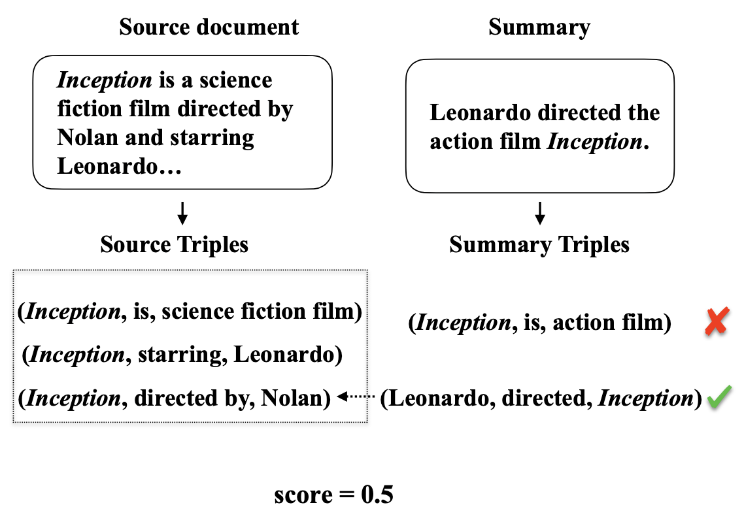
Evaluation Metrics
Model-based Metric – Information Extraction
Extract knowledge in the relational
tuple format
Verify against tuples from the source
/reference
Ignore the words without verifiable information.
Assessing the factual ac- curacy of generated text. 2019’ SIGKDD

Slide 23
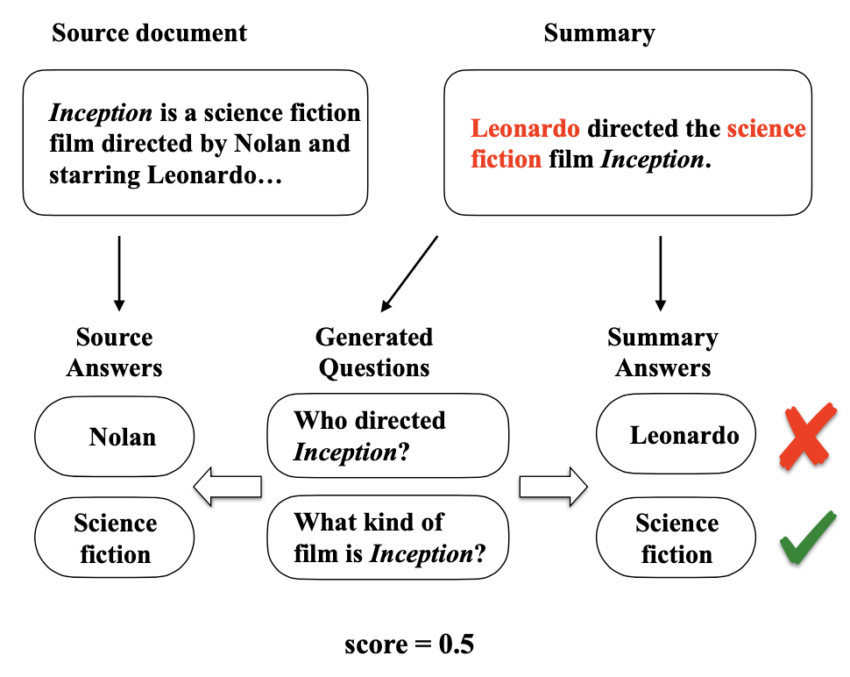
Evaluation Metrics
Model-based Metric – Question Answering
QG model + generation + A’ -> Q
QA model + source + Q -> A
Similarity(A, A’)
Asking and Answering Questions to Evaluate the Factual Consistency of Summaries. 2020’ ACL
Notes:
Intuition: similar answers will be generated from a same question if the generation is factually consistent with the source reference.

Slide 24
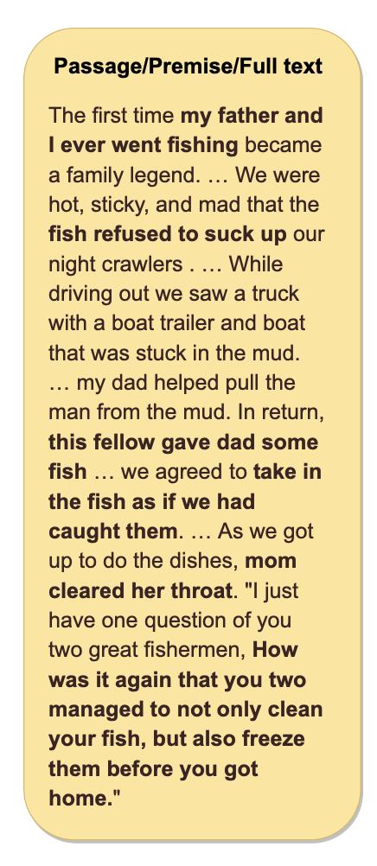
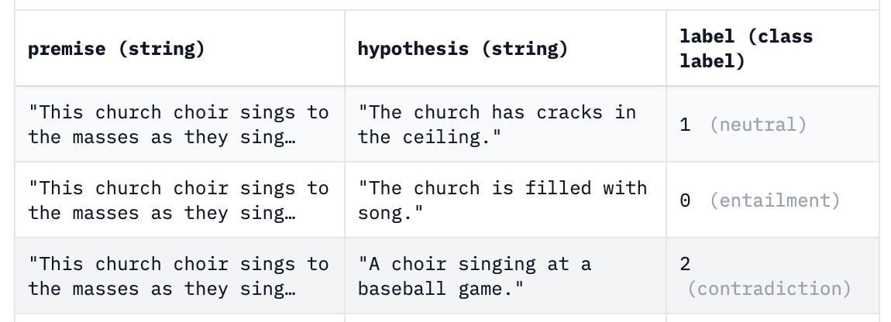
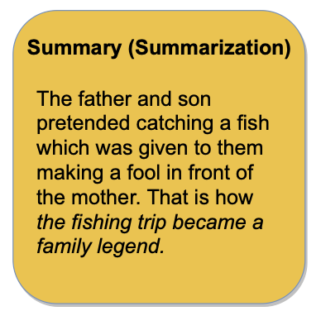
Evaluation Metrics
Model-based Metric – Natural Language Inference
NLI(premise, hypothesis) ~ NLI(source, generation)
Entailment => Faithfulness
Looking Beyond Sentence-Level Natural Language Inference for Question Answering and Text Summarization. 2021’NAACL
Notes:
Based on the idea: only the source knowledge reference should entail the entirety of the information in faithful and hallucination-free generation
more robust to lexical variability
transfer poorly

Slide 25
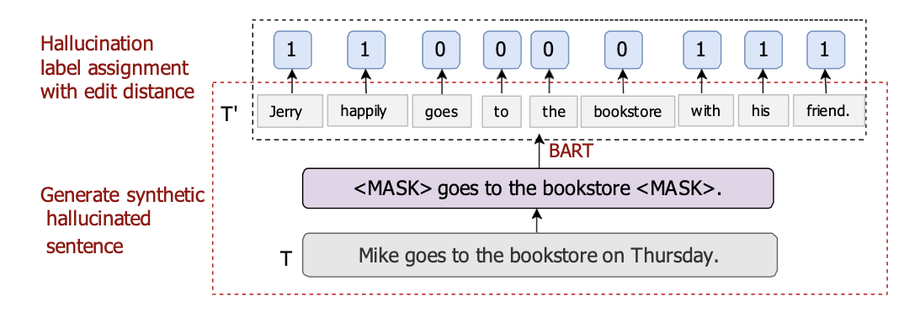
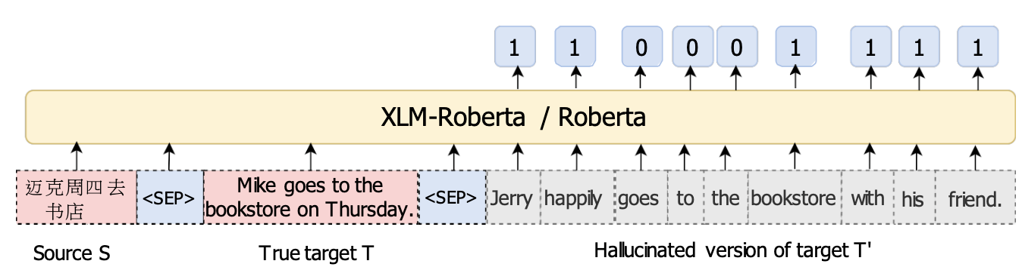
Evaluation Metrics
Model-based Metric – Train Faithfulness Classification Models
Construct task-specific
datasets
Train Classification
models
Detecting Hallucinated Content in Conditional Neural Sequence Generation. 2021’ ACL findings
Notes:
Generation of synthetic data with hallucination labels. A hallucinated version of T is generated by feeding the noised sentence to the encoder-decoder model BART. Hallucination labels are assigned to each token by computing the edit distance between T ′ and T . Labels of 1 refer to hallucinated words.

Slide 26
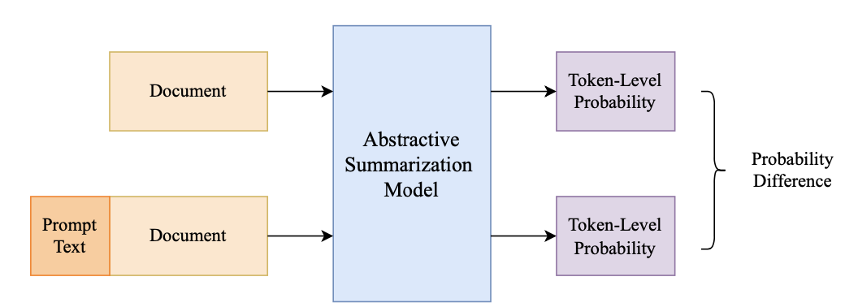
Evaluation Metrics
Model-based Metric – Language Models
Probability differences among two generations of a language model
CoP: Factual Inconsistency Detection by Controlling the Preference. 2023’ AAAI
Notes:
the consistent part in the summary is redundant to the generation model and thus will not bring large changes in probability
* the inconsistent part in the summary will bring a more significant variation in its generation probability

Slide 27
Evaluation Metrics
Human Evaluation
Scoring
Rate the hallucination level in a range
Comparing
Compare the output texts with baselines or references

Slide 28
Evaluation Metrics
Statistical Metric
Can only handle the lexical information.
Fail to deal with syntactic or semantic variations.
Model-based Metric
Error propagations
affect the accurate quantification of hallucinations.
Human Evaluation
Expensive
Hard to reproduce
Notes:
Model-based metrics comprehend the source and generated texts to detect knowledge/content mismatches.

Slide 29
Future Directions for Evaluation Metrics
fine-grained
fact-checking for extrinsic hallucinations
generalization
Notes:
identify the exact location of the hallucinatory sub-strings correctly.
distinguish between the two types of hallucinations
The factual verification of extrinsic hallucinations requires fact-checking against world knowledge,
how to retrieve evidence from the world knowledge.
the source and output text of different tasks are in various forms, investigating their relationship and common ground and proposing general metrics to evaluate hallucinations are worth exploring.

Slide 30
That’s all.

